Slide 1
Collective Communication and Computation Operations
MPI provides an extensive set of functions for performing common collective communication operations.
Each of these operations is defined over a group corresponding to the communicator.
All processors in a communicator must call these operations.

Slide 2
Collective Communication Operations
The barrier synchronization operation is performed in MPI using:
  int MPI_Barrier(MPI_Comm comm)
The one-to-all broadcast operation is:
  int MPI_Bcast(void *buf, int count, MPI_Datatype datatype, int source, MPI_Comm comm)
The all-to-one reduction operation is:
  int MPI_Reduce(void *sendbuf, void *recvbuf, int count, MPI_Datatype datatype, MPI_Op op, int target, MPI_Comm comm)

Slide 3
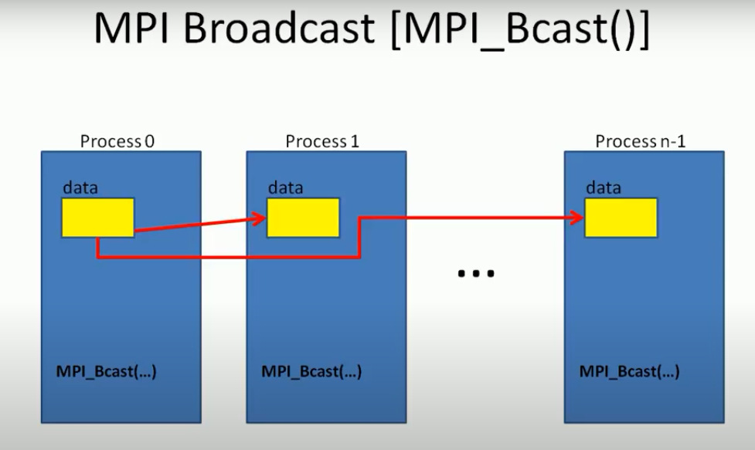


Slide 4
Predefined Reduction Operations
Operation | Meaning | Datatypes
MPI_MAX | Maximum | C integers and floating point
MPI_MIN | Minimum | C integers and floating point
MPI_SUM | Sum | C integers and floating point
MPI_PROD | Product | C integers and floating point
MPI_LAND | Logical AND | C integers
MPI_BAND | Bit-wise AND | C integers and byte
MPI_LOR | Logical OR | C integers
MPI_BOR | Bit-wise OR | C integers and byte
MPI_LXOR | Logical XOR | C integers
MPI_BXOR | Bit-wise XOR | C integers and byte
MPI_MAXLOC | max-min value-location | Data-pairs
MPI_MINLOC | min-min value-location | Data-pairs

Slide 5
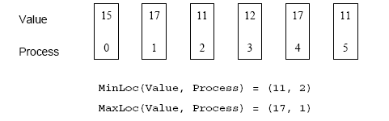
Collective Communication Operations
The operation MPI_MAXLOC combines pairs of values (v_{i}, l_{i}) and returns the pair (v, l) such that v is the maximum among all v_{i} 's and l is the corresponding l_{i} (if there are more than one, it is the smallest among all these l_{i} 's).
MPI_MINLOC does the same, except for minimum value of v_{i}.
An example use of the MPI_MINLOC and MPI_MAXLOC operators.

Slide 6
Collective Communication Operations
MPI datatypes for data-pairs used with the MPI_MAXLOC and MPI_MINLOC reduction operations.
MPI Datatype | C Datatype
MPI_2INT | pair of ints
MPI_SHORT_INT | short and int
MPI_LONG_INT | long and int
MPI_LONG_DOUBLE_INT | long double and int
MPI_FLOAT_INT | float and int
MPI_DOUBLE_INT | double and int

Slide 7
Collective Communication Operations
If the result of the reduction operation is needed by all processes, MPI provides:
  int MPI_Allreduce(void *sendbuf, void *recvbuf,
  int count, MPI_Datatype datatype, MPI_Op op, MPI_Comm comm)
To compute prefix-sums, MPI provides:
  int MPI_Scan(void *sendbuf, void *recvbuf, int count, MPI_Datatype datatype, MPI_Op op,
  MPI_Comm comm)

Slide 8

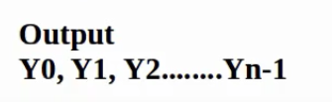




To compute prefix-sums, MPI provides:
  int MPI_Scan(void *sendbuf, void *recvbuf, int count, MPI_Datatype datatype, MPI_Op op,
  MPI_Comm comm)

Slide 9
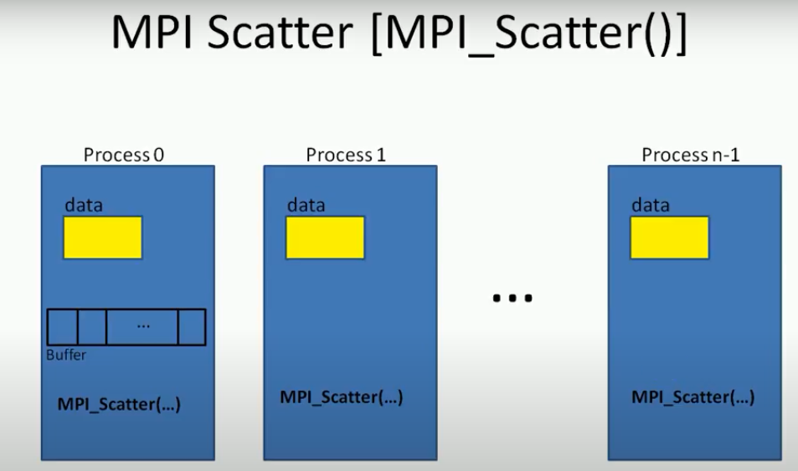

Slide 10
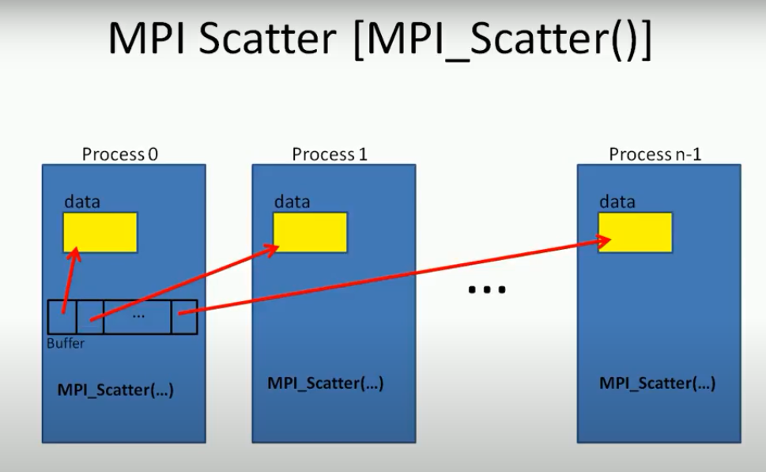

Slide 11
Collective Communication Operations
The gather operation is performed in MPI using:
  int MPI_Gather(void *sendbuf, int sendcount,
  MPI_Datatype senddatatype, void *recvbuf,
  int recvcount, MPI_Datatype recvdatatype,
  int target, MPI_Comm comm)
MPI also provides the MPI_Allgather function in which the data are gathered at all the processes.
  int MPI_Allgather(void *sendbuf, int sendcount, MPI_Datatype senddatatype, void *recvbuf,
  int recvcount, MPI_Datatype recvdatatype,
  MPI_Comm comm)
The corresponding scatter operation is:
  int MPI_Scatter(void *sendbuf, int sendcount,
  MPI_Datatype senddatatype, void *recvbuf,
  int recvcount, MPI_Datatype recvdatatype,
  int source, MPI_Comm comm)

Slide 12
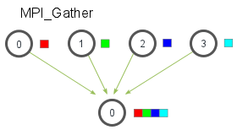

Slide 13
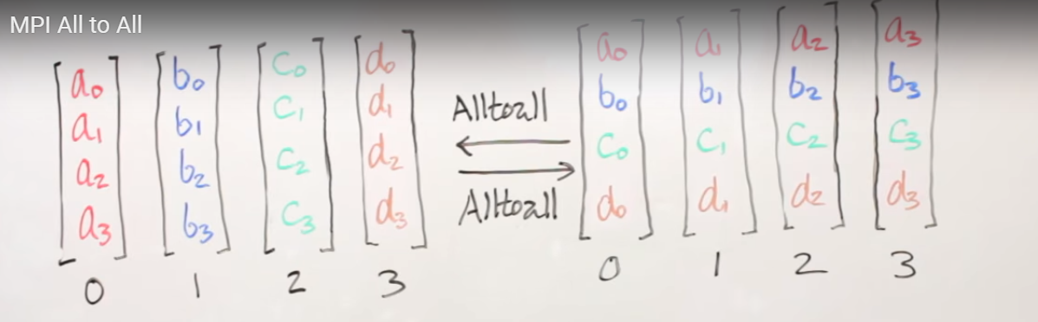
Collective Communication Operations
The all-to-all personalized communication operation is performed by:
  int MPI_Alltoall(void *sendbuf, int sendcount, MPI_Datatype senddatatype, void *recvbuf,
  int recvcount, MPI_Datatype recvdatatype, MPI_Comm comm)
Using this core set of collective operations, a number of programs can be greatly simplified.

Slide 14
Groups and Communicators
In many parallel algorithms, communication operations need to be restricted to certain subsets of processes.
MPI provides mechanisms for partitioning the group of processes that belong to a communicator into subgroups each corresponding to a different communicator.
The simplest such mechanism is:
  int MPI_Comm_split(MPI_Comm comm, int color, int key, MPI_Comm *newcomm)
This operation groups processors by color and sorts resulting groups on the key.

Slide 15
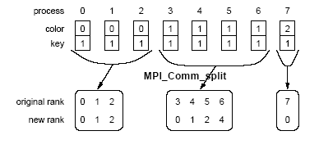
Groups and Communicators
Using MPI_Comm_split to split a group of processes in a communicator into subgroups.

Slide 16
Groups and Communicators
In many parallel algorithms, processes are arranged in a virtual grid, and in different steps of the algorithm, communication needs to be restricted to a different subset of the grid.
MPI provides a convenient way to partition a Cartesian topology to form lower-dimensional grids:
  int MPI_Cart_sub(MPI_Comm comm_cart, int *keep_dims, MPI_Comm *comm_subcart)
If keep_dims[i] is true (non-zero value in C) then the ith dimension is retained in the new sub-topology.
The coordinate of a process in a sub-topology created by MPI_Cart_sub can be obtained from its coordinate in the original topology by disregarding the coordinates that correspond to the dimensions that were not retained.

Slide 17
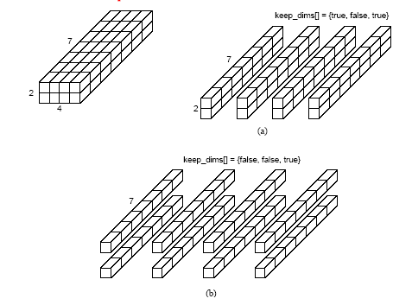
Groups and Communicators
Splitting a Cartesian topology of size 2 x 4 x 7 into (a) four
subgroups of size 2 x 1 x 7, and (b) eight subgroups of size 1 x 1 x 7.

